Slide 1
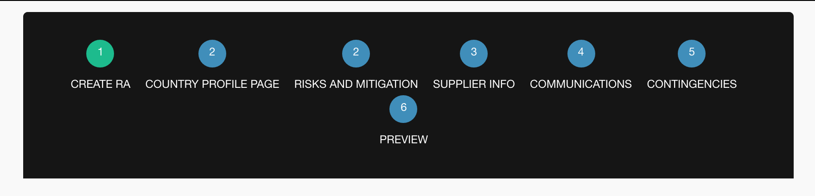
Create RA template:
1.Country profile page and risks and mitigation share the same breadcrumb number. Should be numerical order

Slide 2
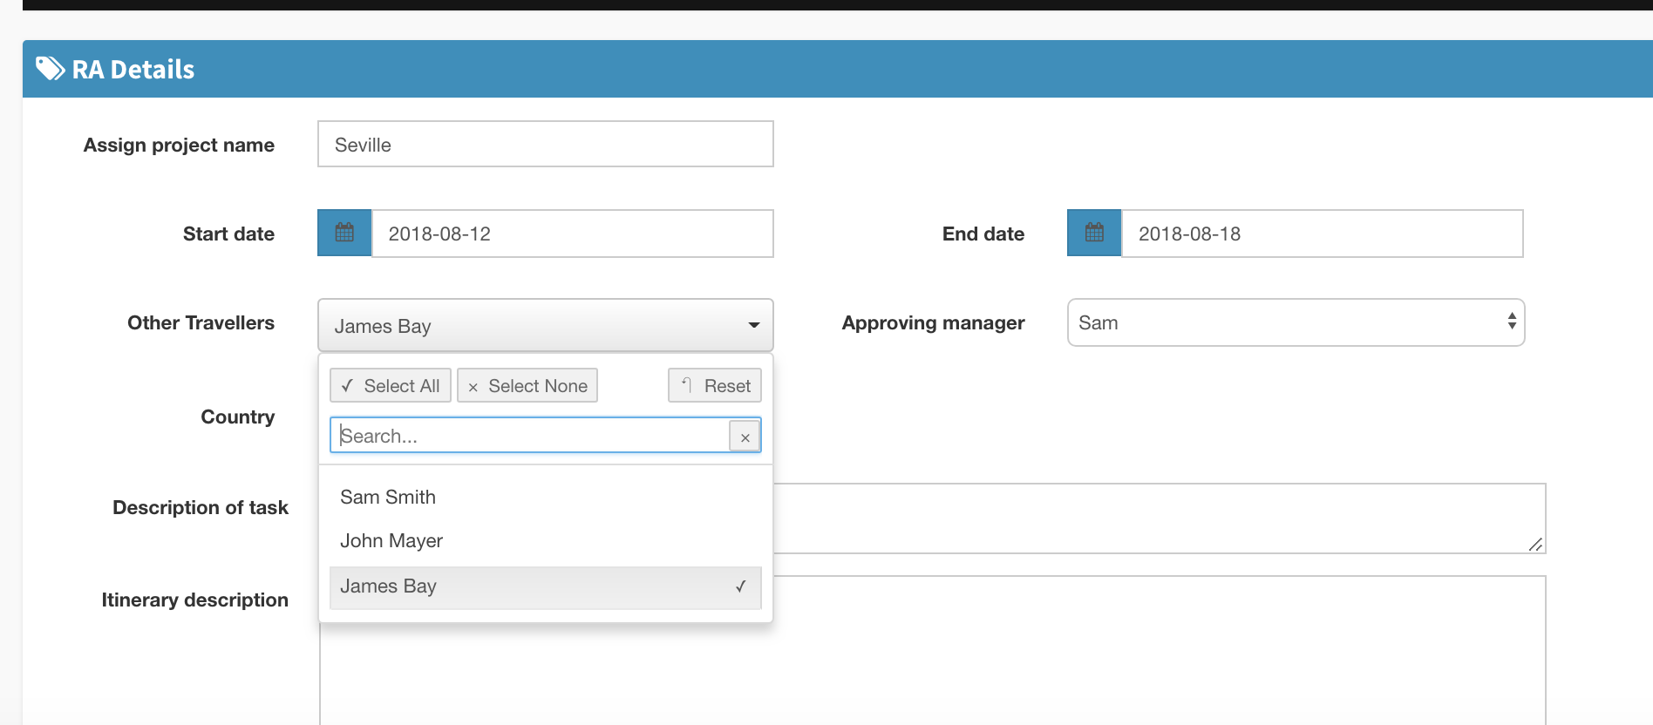
Creating a RA:
Last names included for traveller but not for approving manager - difficult if two managers have same first name. Can it be changed so that the Approving Managers full name is included?

Slide 3
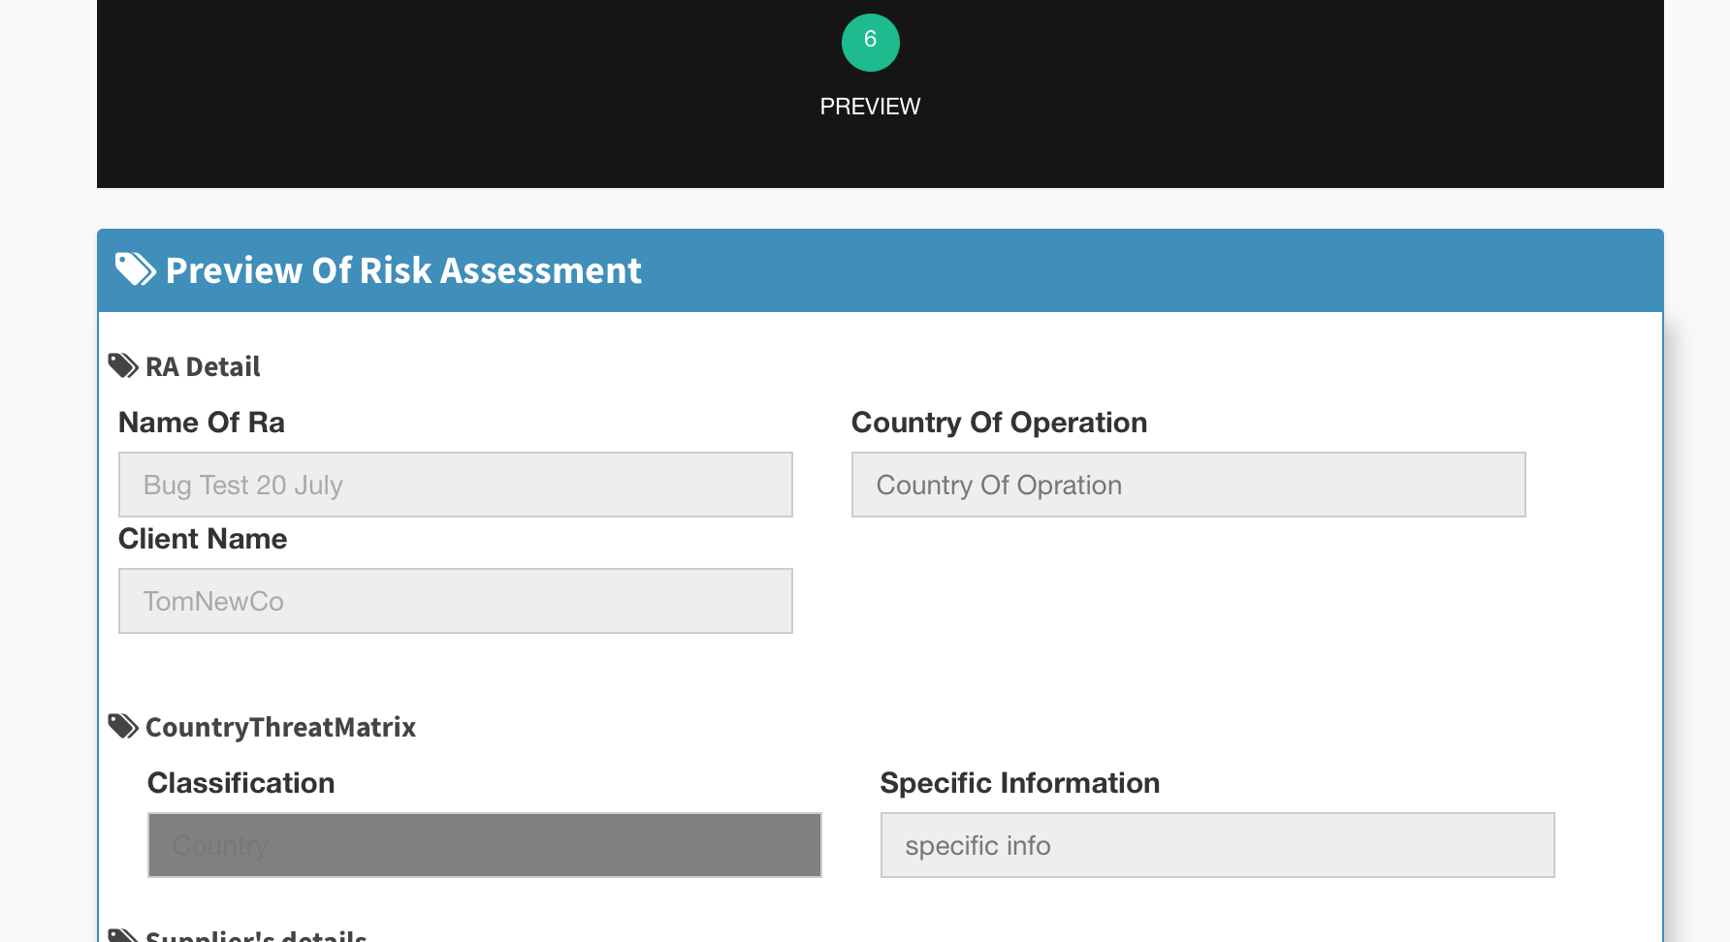
Create RA template. Breadcrumb 6) Preview.
Ghost text from unanswered fields should not carry across to the preview or PDF.
When a template is not country specific (when all is selected) it should not carry the country-specific fields into the template.
Specific Information box should be removed.

Slide 4
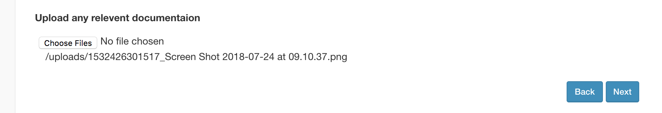
Author receives More Information Request:
See what the author sees in Breadcrumb 7. There is no way for the author to remove the file.
2. Missing approve and share button in this breadcrumb

Slide 5
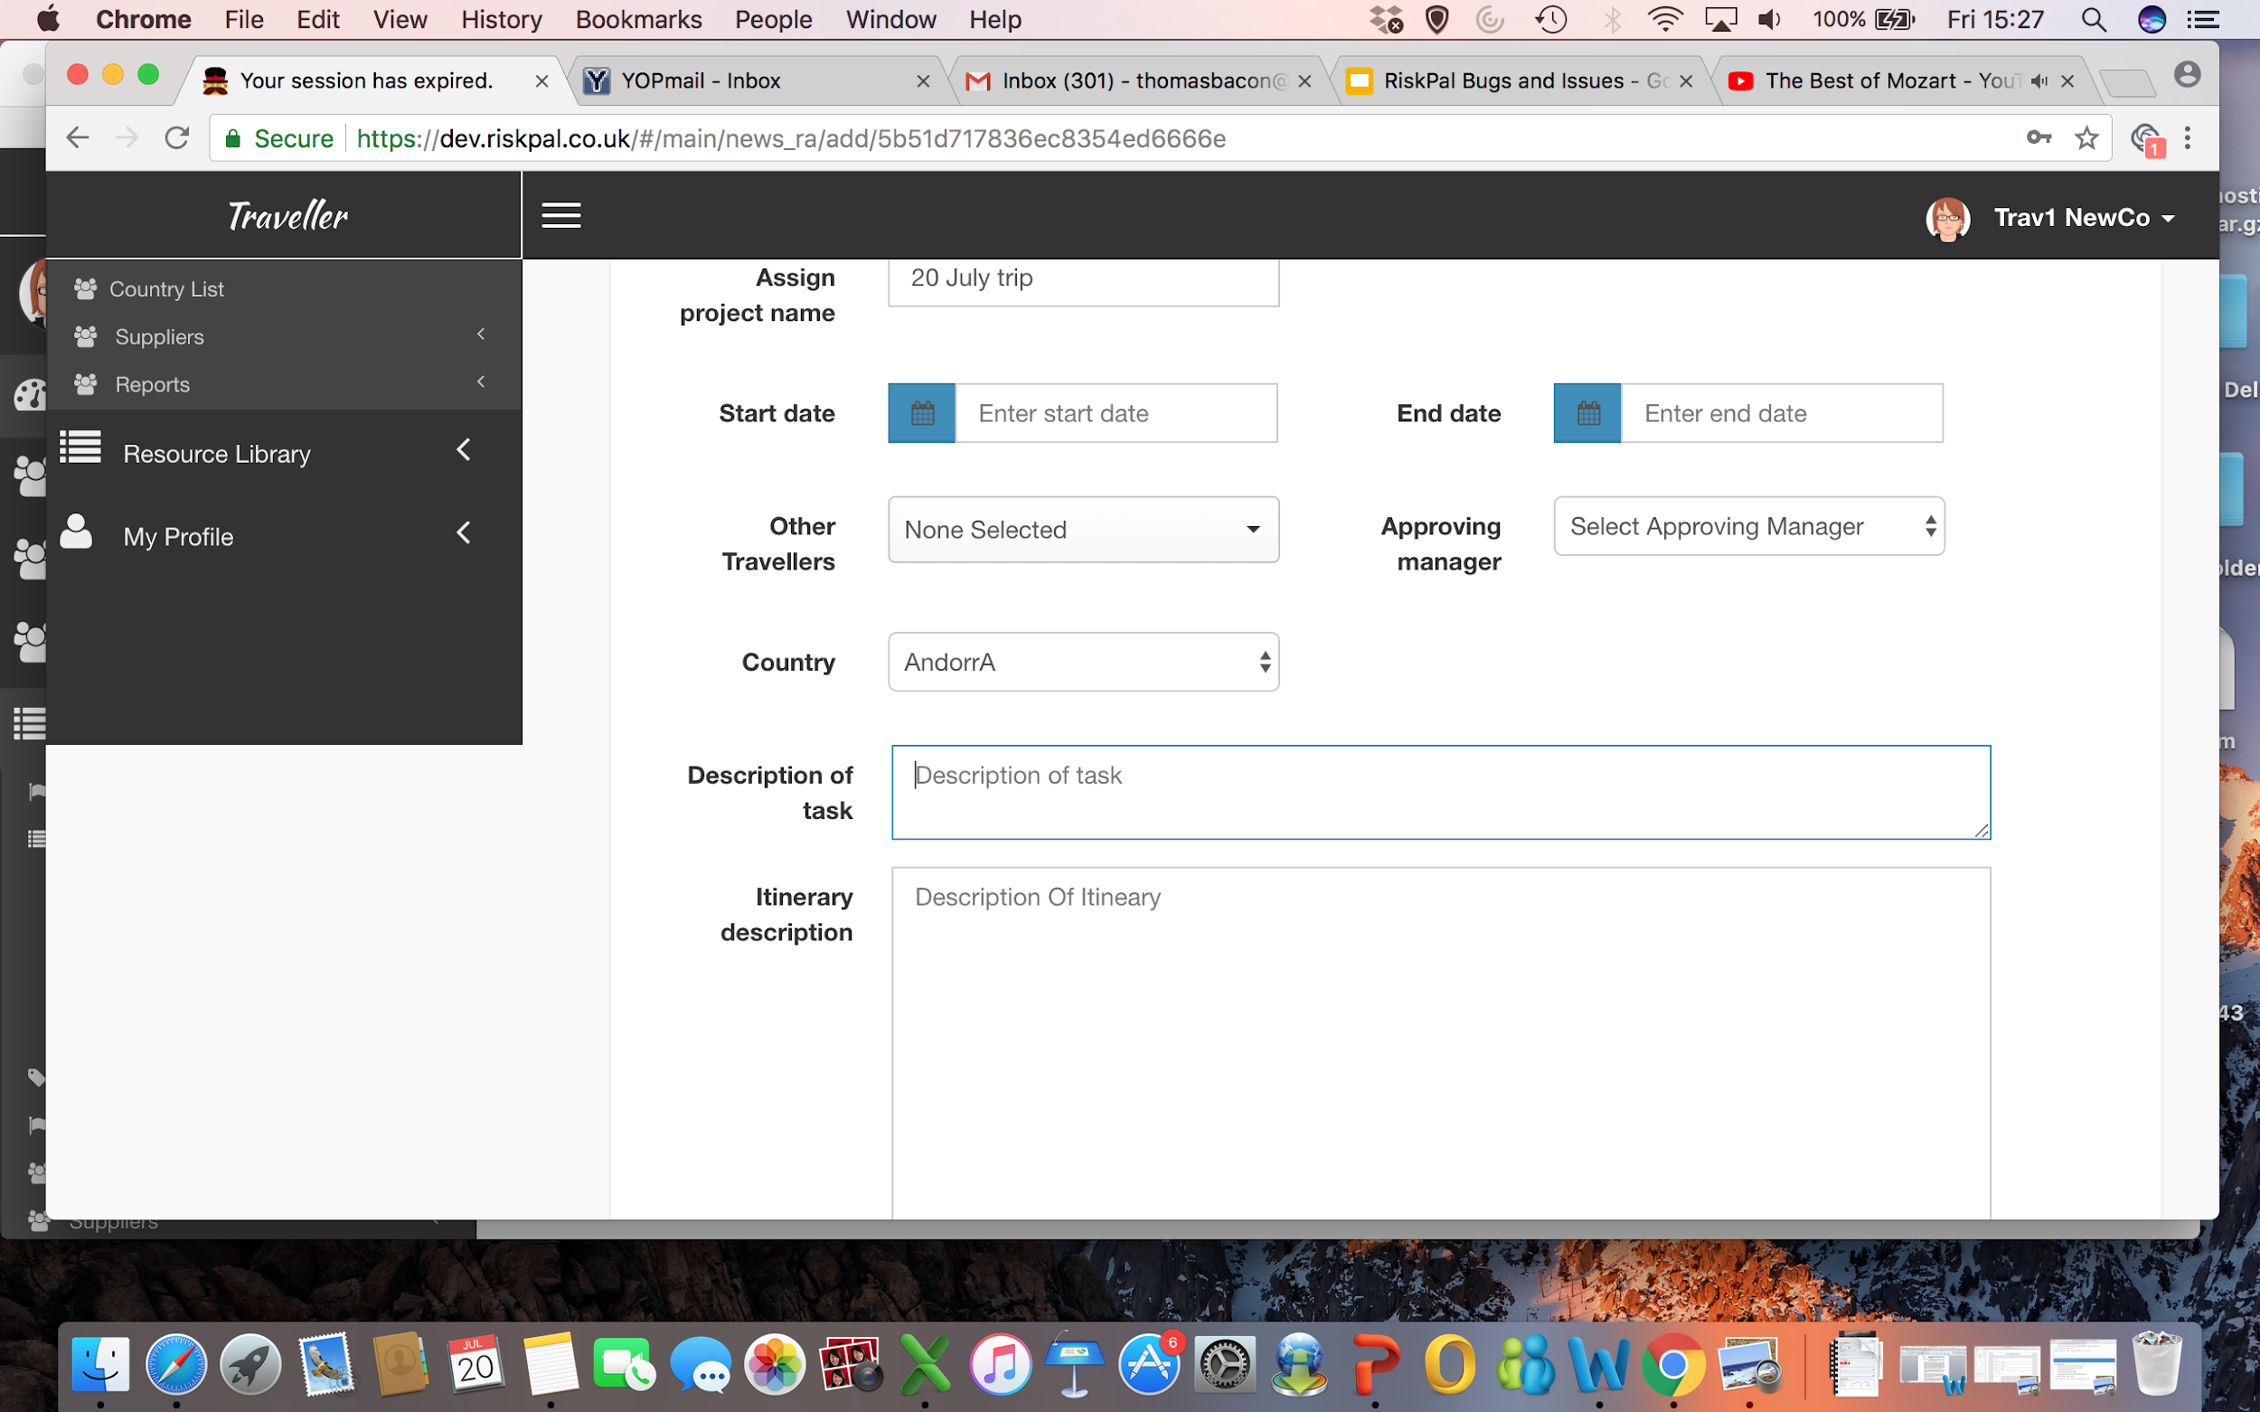
Once a session expires and you log back in, the Your session has expired remains in the tab title.

Slide 6
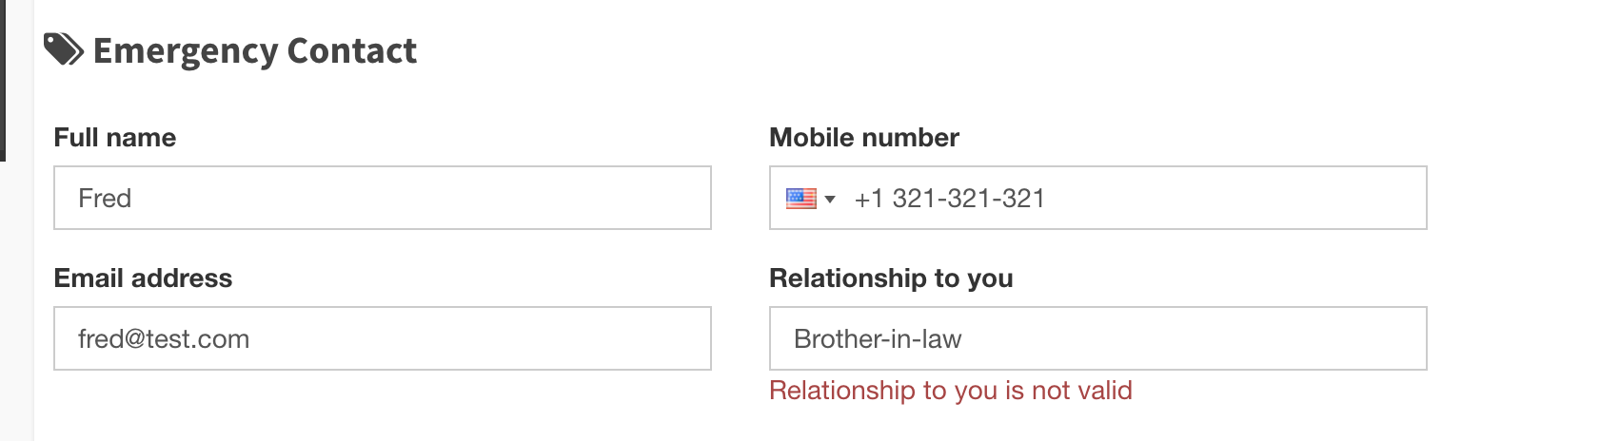
Text restrictions throughout - can we remove restrictions on symbols and numbers in multiple fields. Ruby can you review in the system where these feature- RA fields, template fields (create and edit), My Profile etc

